Slide 1

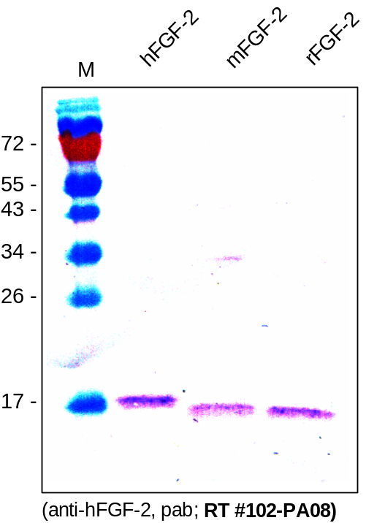
ReliaTech GmbH
Cross-reactivity of anti-human FGF-2 (basic)
(Cat #102-PA08S / -PA08)
Fig. 1: Test of cross-reactivity of anti-human FGF-2 polyclonal antibody by Western blot analysis. Recombinant human, mouse and rat FGF-2 produced in E. coli were loaded under reducing conditions in 15% SDS-polyacrylamide gel. Anti-human FGF-2 recognizes also the mouse and the rat form.
http://www.reliatech.de / orders@reliatech.de

